Slide 1
Improving Student Ownership in Introductory Statistics Classes through a Project Based Approach.
Vinodh Kumar Chellamuthu
Department of Mathematics
Dixie State University

Slide 2
Why Active learning in Mathematics and Statistics?
Role of Mathematics and Statistics is Changing:
More fields require more mathematics (e.g. data science, bioinformatics, finance)
Most of the business and government decision-making require data analysis
Technology has Changed the Way Mathematics and Statistics are Done:
Python, MATLAB, Mathematica, Excel, statistical software, etc.
Data source is growing and we need skillset to analyze those data
Business and industry run on technology
Students are Changing:
Expect to see how mathematics is related to their field of interest. Expect to use technology
Don’t learn well in passive lectures

Slide 3
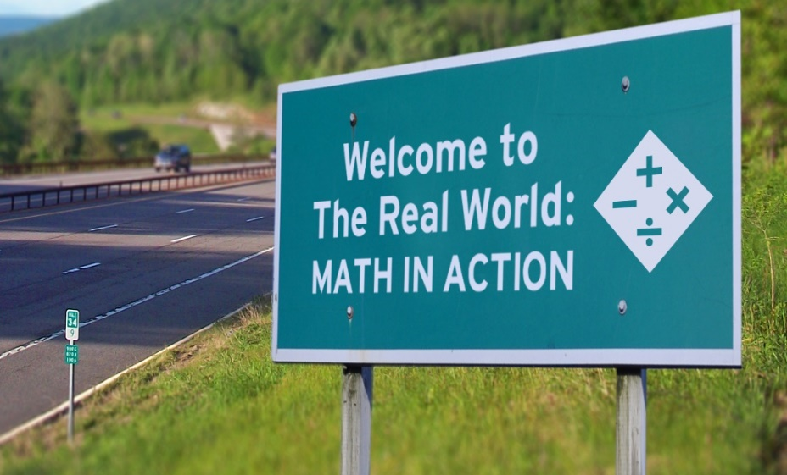
To Enable Students to Use Their Mathematics in Other Settings
Mathematics needs to be taught showing its connections to other fields
(Statistics courses…Biostatistics…Business Stat….Stat. for Psychology…)
Otherwise students think of it as unrelated and not useful
Problems are needed that probe student conceptual understanding
Otherwise some students only memorize
This is true for any subject. However, math is special in this aspect…..☹

Slide 4
Why we need to approach mathematics learning this way?

Slide 5


We would like to go from this

Slide 6



To this.
Life skills through mathematics
Why these skills are important?
Asking Questions
Collaborating as a team
Communicating the findings/report to general audience

Slide 7
What’s the Problem (Our Problem)?
Currently, most of the students are not realizing the importance of the General Education courses and its connection to their respective majors.
Instead they treat these courses as one of the GE checklist. For example, Math 1040 (Intro. to Stat).
Most of the students in Math 1040 are nursing, criminal justice, exercise science, and psychology majors.
It is critical that these majors understand statistics by applying the classroom knowledge to their future careers.

Slide 8
How do we change this attitude within the student population?

Slide 9

I was experimenting an semester long project to encourage students to do statistics in my class through hands-on activities by stressing conceptual understanding rather than memorization of procedures.
This project stressed the importance of the Math 1040 (GE course) and made students to understand the connection to their major study.

Slide 10

Students picked a data set (based on their passion or major study) from StatCrunch (https://www.statcrunch.com/).
Students gave a brief description of the data set and sample methods, and why they chose specific methods for their topic.
Depending on the data set, students used skills from the lecture to either display the data, gave an analysis or both.

Slide 11
After students analyze the data set, they should write a short summary describing the analysis of the data set. Specifically, what their Display/Quantitative analysis describe about the sample (descriptive statistics).
Students should at least once, after finishing the paper, meet with the writing tutor.

Slide 12
Sample Data Sets/Projects
Nutritional Data for Fast Food 2017
Shark Attacks Worldwide
Dental Hygiene
Cancer Survival
Super Heroes
NBA Salary 2017
Movie Budgets and Box Office Earnings

Slide 13
Grading Rubric Math 1040 Part 1
Data set, analysis, and conclusion
Due Date: **********
Grading Criteria | Possible Points
Pick a Data Set (Explain why you chose this particular data set) | 15
Survey methodology (describing the data - at least 5 qualitative/5 quantitative) | 20
Display/Quantitative analysis of the data set | 25
Summary of the survey | 30
Meeting with the writing tutor | 10
Total: | 100

Slide 14
Statistic Poster Showcase
https://youtu.be/W12Dsmutfsc

Slide 15
Feedback from the students:
➢ The project was pretty fun. I liked it more than a regular class with regular class work. It did take a lot of time and effort, but it was worth it. I was fairly nervous for the first judge but after getting to practice the second judge was easier. The project overall was a good idea only commentary would be to do it earlier in the semester.
I enjoyed the poster presentation because it was a good rather than doing the homework. It was good to be able to apply statistics to real life. It might be good to do a group project so that if one student is lacking knowledge on one subject another can help them.
➢ I though the poster was a great experience having students present is typically something only found in upper division classes. It always increases learning when students must teach, giving us a long-term goal to accomplish was also very pragmatic.
https://youtu.be/W12Dsmutfsc

Slide 16
Feedback from the students:
➢ The project was useful to me because it helped me put everything that we learned all semester into a real-life scenario, and I was glad we got to choose our data sets because I was really interested in my data set, so it helped my motivation to do it. I think although it took a ton of time and was frustrating at some points, it was a good experience.
➢ I didn’t expect to do the presentation when I signed up for this class. When I found out that it was required, I didn’t want to do it, but I feel that in doing self-motivated research and application of ideas. I learned better than simply doing assignments.
➢ The presentation of projects has helped me understand how statistics work in real life situations especially with in my major.
➢ I will admit, at first, I did not get too excited about the project. But at the day of presentation, my perspective changed. I realized how cool it was. I enjoyed talking about my data and the findings I made. It was fun! It was much better than studying another unit for a test. Thank you, Vino! Fun project!

Slide 17
Acknowledgement
DSU Center for Teaching and Learning Learning Innovation Grant – Fall 2018
DSU Math Department
All my “mathy” friends

Slide 18
Thanks for your time.
Any Questions?

